Slide 1


Slide 2
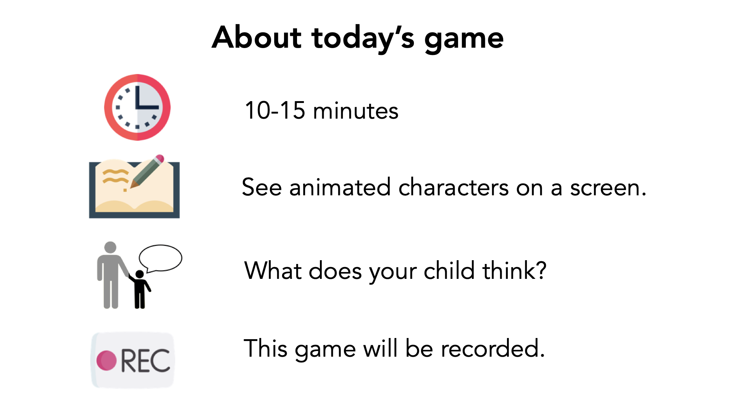

Slide 3
Verbal Consent
"I have read and understand the consent document. I am this child's parent or legal guardian and we both agree to participate in this study."

Slide 4


Slide 5


Notes:
This is Percy! I am going to tell you a story about him!

Slide 6
Negative Condition

Slide 7



Notes:
In school today, Percy learned that foxes move without making any sound.

Slide 8


Notes:
Percy also got a bad grade on his test. [click] This made him sad [click]

Slide 9



Notes:
While waiting to get on the bus after school, Percy saw a classmate named Avery. Percy and Avery know each other but they don’t play together. Avery said “Hi Percy! How was school today?”
Percy told Avery about how he learned foxes move without making sounds. [click 2x]

Slide 10
Notes:
Percy did not tell Avery about the bad grade on his test. [click 3x]

Slide 11
Notes:
While waiting to get on the bus after school, Percy saw a classmate named Avery. Percy and Avery know each other but they don’t play together. Avery said “Hi Percy! How was school today?”
Percy told Avery about the bad grade on his test. [click 2x]

Slide 12
Notes:
Percy did not tell Avery about how he learned that foxes move without sounds. [click 3x]

Slide 13

Very Bad
Bad
Good
Very Good
Notes:
How good or bad was it that Percy did tell about the foxes? Why?
How good or bad was it that Percy did not tell about the bad grade? Why?

Slide 14
Very Sad
Sad
Happy
Very Happy
Notes:
How do you think Percy feels after not telling Avery about his bad grade?

Slide 15
Very Sad
Sad
Happy
Very Happy
Notes:
Later, Avery found out that Percy didn’t tell him about his bad grade
How do you think Avery feels after Percy not telling about his bad grade? Why?

Slide 16


Notes:
On the way home, Percy saw his best friend Orin! Orin said “Hey Percy! How was school today?”
Percy told Orin about the bad grade on his test. [click 2x]

Slide 17
Notes:
Percy did not tell Orin about how he learned that foxes move without sounds. [click 3x]

Slide 18
Notes:
On the way home, Percy saw his best friend Orin! Orin said “Hey Percy! How was school today?”
Percy told Orin about how he learned that foxes move without sounds. [click 2x]

Slide 19
Notes:
Percy did not tell Orin about the bad grade on his test. [click 3x]

Slide 20
Very Bad
Bad
Good
Very Good
Notes:
How good or bad was it that Percy did tell Orin about the foxes? Why?
How good or bad was it that Percy did not tell Orin about the bad grade? Why?

Slide 21
Very Sad
Sad
Happy
Very Happy
Notes:
How do you think Percy feels after not telling Orin about his bad grade?

Slide 22
Very Sad
Sad
Happy
Very Happy
Notes:
Later, Orin found out that Percy didn’t tell him about his bad grade.
How do you think Orin feels about Percy not telling him about his bad grade? Why?

Slide 23
Positive Condition

Slide 24
Notes:
Percy learned in school that foxes move without making any sound.

Slide 25

Notes:
Percy also received a gold star in school today for participation!

Slide 26
Best Friends
Notes:
On the way home from school, Percy saw his best friend Orin! Orin said “Hey Percy! How was school today?” Percy told Orin the fact that he learned about foxes

Slide 27
Best Friends
Notes:
But Percy didn’t tell Orin that he earned a gold star

Slide 28
Best Friends
Notes:
Percy didn’t tell Orin the fact he learned about foxes

Slide 29
Best Friends
Notes:
But Percy did tell Orin about the gold star that he received

Slide 30



Notes:
Later that day, Percy went to the playground and met a boy named Kendall who he didn’t know before.
Kendall said, “Nice to meet you Percy! How was school today?”
Percy told Kendall about how he learned foxes move without sounds. [click 2x]

Slide 31
Notes:
Percy did not tell Kendall about the bad grade on his test. [click 3x]

Slide 32
Notes:
Later that day, Percy went to the playground and met a boy named Kendall who he didn’t know before.
Kendall said, “Nice to meet you Percy! How was school today?”
Percy told Kendall about the bad grade on his test. [click 2x]

Slide 33
Notes:
Percy did not tell Kendall about how he learned foxes move without sounds. [click 3x]

Slide 34
Very Bad
Bad
Good
Very Good
Notes:
How good or bad was it that Percy did not tell Kendall about his bad grade? Why?
How good or bad was it that Percy did tell Kendall about the foxes? Why?

Slide 35
Very Sad
Sad
Happy
Very Happy
Notes:
How do you think Percy feels after not telling Kendall about his bad grade?

Slide 36
Very Sad
Sad
Happy
Very Happy
Notes:
Later, Kendall found out that Percy didn’t tell him about the bad grade.
How do you think Kendall feels about Percy not telling him about his bad grade? Why?

Slide 37


Slide 38
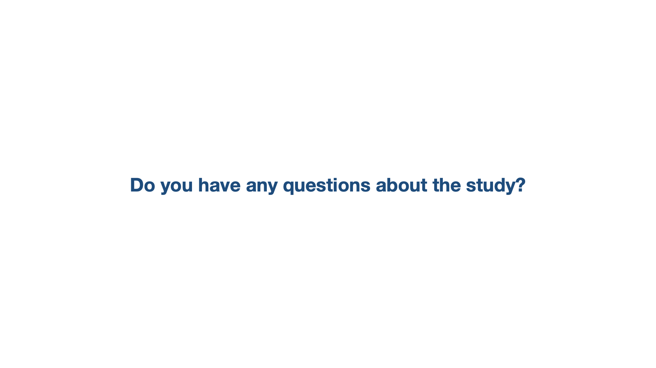

Slide 39


Slide 40


Slide 41
Best Friends

